Slide 1
St Mary’s Catholic Primary School
KS1
07.12.20
This session will look at how we teach the four operations in school, so that you can help your children at home.

Slide 2
Counting Principles
Before children can begin to calculate they need to be competent in counting
The ‘How to count’ principles
  The stable order principle
  The 1-1 principle
  The cardinal principle
The ‘What to count’ principles
  The order-irrelevance principle
  The abstract principle
Gelman R and Gallistell CR. (1978)
‘The Child’s Understanding of Number’
Notes:
Reference Gelman and Gallistell (1978) ‘the Childs understanding of number’ who decided that children understood about counting based on 5 principles.
The first three are the ‘how to count’ principles:
The one-one principle: the ability to assign one number name to one object, in the correct order. And tag each object once only. Older children who are struggling to understand number may not have grasped this concept. It needs direct teaching.
The stable order principle: the number names need to be recited in the specific order consistently. So if counting four objects, children need to be able to say one, two, three, four each time they count.
The cardinal principle: when children are able to count with a stable order, and understand the one : one principle, they begin to notice the final number in the count has a special significance. This tells us ‘how many’ in the set. This is the cardinal principle. Connected to this is the idea that children understand that the procedure of counting leads to determining quantity and is not just an end in itself.
The last two are the ‘What to Count’ principles;
The abstract principle: counting can be applied to any collection of entities. Children can count anything (objects, ideas, sounds etc.) and they understand that they can count different ‘things’, e.g. You can count all the cups on the table, you can count all the biscuits on the table. But you can count all the things on the table.
The order-irrelevance principle: when counting a group of objects, as long as all the objects are counted and each object is only counted once, it does not matter where the counting starts.

Slide 3
I can say 1, 2, 3 (stable order)
1
2
3
I can count 1, 2, 3 frogs
(1:1 correspondence)
I can tell you that there are 3 frogs (cardinal)
I can tell you that there are still
3 frogs, I don’t have to count them again
(order irrelevance)
I can count anything now! (abstraction)

Slide 4
They also need to:
  Know all about numbers to 10
  Subitise
  Recognise numbers to 10
Show me 4 in as many ways as you can.
What do you know about 4?
Odd or even?
What is it greater than? What is it less than?
Can you count out 4 from a larger group?
Can you show the numeral?
Number pairs for 4: part, part, whole model leading to number facts and generalisation.
3 + 1 = 4
1 + 3 = 4
4 – 1 = 3
4 – 3 = 1
4
4
3
1
3
1

Slide 5
Structures for addition
Augmentation
Augend add addend equals sum
Aggregation
Addend add addend equals sum

Slide 6
Augmentation
Augend add addend equals sum
Sofia has 6 apples.
Her mother gave her 4 more.
How many apples does she have now?
4
6
Aggregation
Addend add addend equals sum
Sofia has 6 apples.
Her mother has 4.
How many do they have altogether?
6
10
4

Slide 7
Structures for subtraction
Reduction
Removing items from a set
Comparison or difference
15 - 9
15 - 9
15
9
6
Minuend subtract subtrahend equals difference

Slide 8
When we calculate these are the models:
Part
Part
Whole
Whole
Part
Part
Augend
Addend
Minuend
Difference
Subtrahend
Sum (or total)
53 + 18 =
augend + addend = sum (or total)
53 - 18 =
minuend – subtrahend = difference
Notes:
Addend – a number added to another number
Sum – from the Latin ‘summus’ which means highest
Children can also reason about the properties of these operations. These properties are based on the idea of a number ‘triple’
COMMUTATIVITY
a+b=b+a
For addition two parts brought together give the whole. Understanding which are the parts and what is the whole helps children to understand commutativity.
ASSOCIATIVE LAW FOR ADDITION
(a+b)+c=a+(b+c)
4+4+6=4+(4+6)=4+10=14
SUBTRACTION COMPLEMENT
a-b=c implies that a-c=b
For 16-7=9 and 16-9=7 we have kept the whole the same and swapped the parts we are subtracting. Because the two parts are the same in character, ie they are both parts then this swapping over works. This will also help to explaining the remaining two principles.
INVERSION PRINCIPLE
a+b=c implies that c-a=b and c-b=a
THREE TERM INVERSE PROPERTY
a+b-b=a

Slide 9
These models are particularly good for missing number problems
Part
Part
Whole
8
?
? + 5 = 11
?
5
8 + ? = 15
15
11
53 + ? = 67
53
?
? + 48 = 83
?
48
67
83
14 - ? = 6
?
6
? - 9 = 5
9
5
14
?
62 - ? = 41
?
41
? - 36 = 41
36
41
62
?
Notes:
Addend – a number added to another number
Sum – from the Latin ‘summus’ which means highest
Children can also reason about the properties of these operations. These properties are based on the idea of a number ‘triple’
COMMUTATIVITY
a+b=b+a
For addition two parts brought together give the whole. Understanding which are the parts and what is the whole helps children to understand commutativity.
ASSOCIATIVE LAW FOR ADDITION
(a+b)+c=a+(b+c)
4+4+6=4+(4+6)=4+10=14
SUBTRACTION COMPLEMENT
a-b=c implies that a-c=b
For 16-7=9 and 16-9=7 we have kept the whole the same and swapped the parts we are subtracting. Because the two parts are the same in character, ie they are both parts then this swapping over works. This will also help to explaining the remaining two principles.
INVERSION PRINCIPLE
a+b=c implies that c-a=b and c-b=a
THREE TERM INVERSE PROPERTY
a+b-b=a

Slide 10
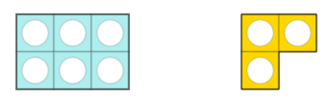
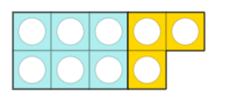
6 + 3 = 9
If we know this what else do we know?
3 + 6 = 9
because addition is commutative
9 – 6 = 3
9 – 3 = 6
because subtraction is inverse

Slide 11
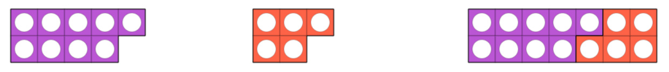
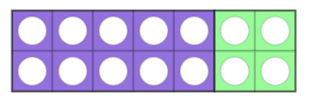
9 + 5 = 14
We also know:
5 + 9 = 14
14 – 9 = 5
14 – 5 = 9
9 + 5 = 10 + 4 = 14
This is a mental calculation strategy that we call making 10.
It reinforces and applies knowledge of number bonds to 10.

Slide 12
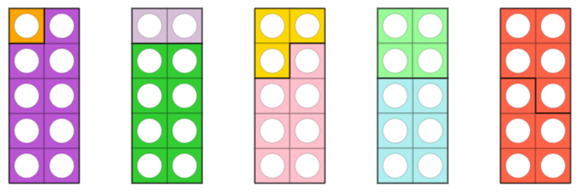
Number bonds to 10
1 + 9 = 10
9 + 1 = 10
10 – 9 = 1
10 – 1 = 9
2 + 8 = 10
8 + 2 = 10
10 – 8 = 2
10 – 2 = 8
3 + 7 = 10
7 + 3 = 10
10 – 7 = 3
10 – 3 = 7
4 + 6 = 10
6 + 4 = 10
10 – 6 = 4
10 – 4 = 6
5 + 5 = 10
10 – 5 = 5

Slide 13
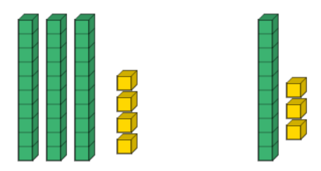
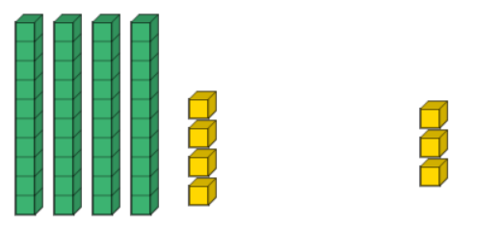
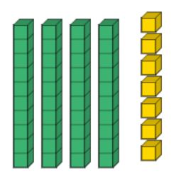
We check by subtracting the addend from the sum.
34 + 13
47
44 + 3
This is a mental calculation strategy that we call sequencing.
We add the tens first and then the ones.

Slide 14
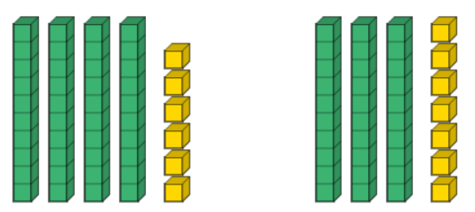
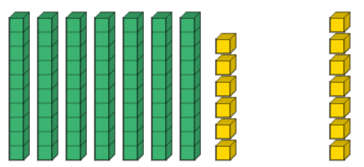
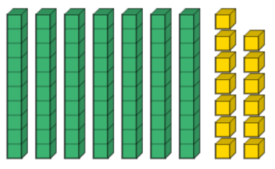
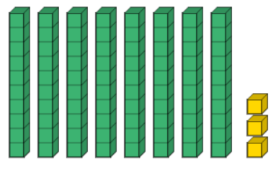
We check by subtracting the addend from the sum.
46 + 37
Add the tens first to give 76 + 7
Add the ones to give 70 + 13
Exchange 10 ones to make one 10
80 + 3 = 83

Slide 15
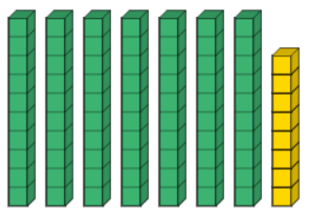
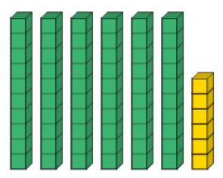
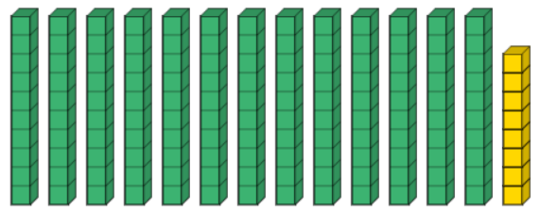
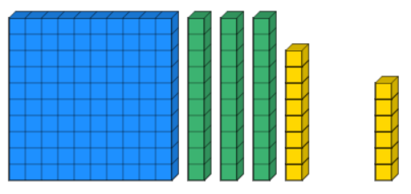

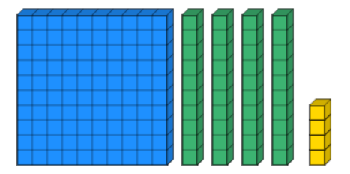
100 + 40 + 4 = 144
    7 8
    + 6 6
    1 3 0
    1 4
    1 1 4
78 + 66
Add the 10s
Exchange 10 tens for one 100
Add the 1s
Exchange 10 ones for one 10

Slide 16
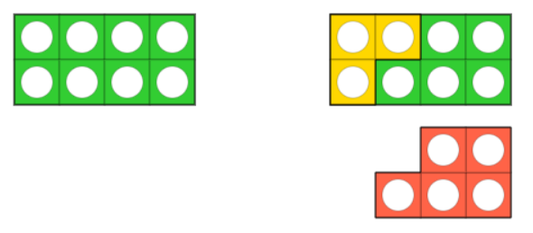
8 - 3 = 5
If we know this what else do we know?
8 - 5 = 3
3 + 5 = 8
5 + 3 = 8

Slide 17
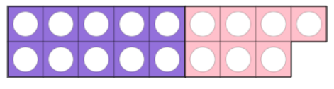
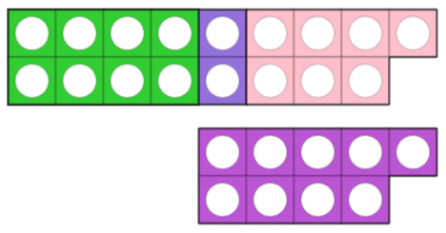
17 - 8 = 9

Slide 18
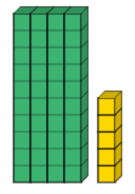
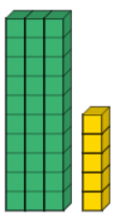
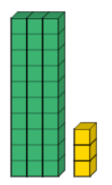
We check by adding the subtrahend and the difference.
45 - 12
We use sequencing to subtract.
Subtract 10 first. Now we have
35 - 2
Next subtract 2 to give a difference of 33

Slide 19
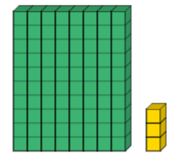
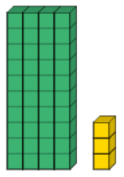
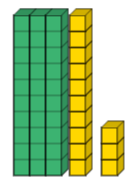
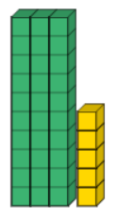
Subtract four 10s first. Now we have
43 - 8
This is as far as Year 2 children go.
Most significant digits are always dealt with first.
We change one thing only. The thing that changes is the size of the number.
Written methods are introduced in Year 3.
83 - 48
We need to subtract 8 ones.
We don’t have enough.
We exchange one 10 for 10 ones.
Now we can subtract 8.
That leaves a difference of 35.

Slide 20
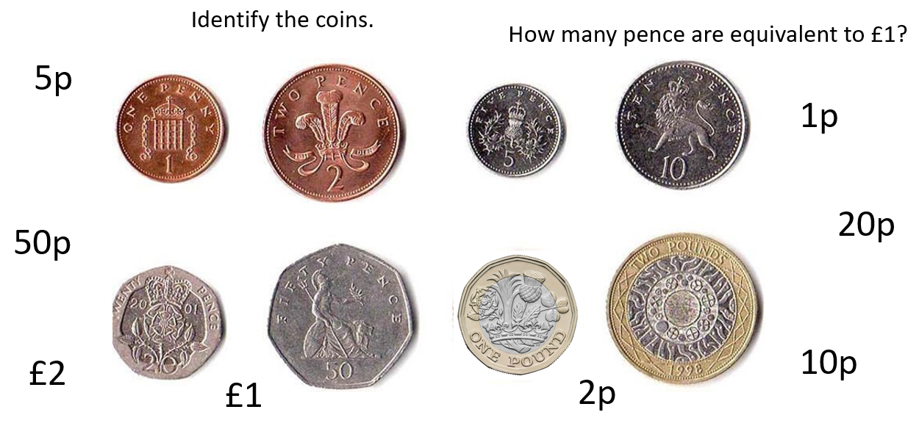
We always apply addition and subtraction to measurement.
Measurement is the everyday application of the maths that we do. We want them to understand that the process of addition and subtraction is the same for anything.
How many ways can you make 10p? 20p? 15p?

Slide 21
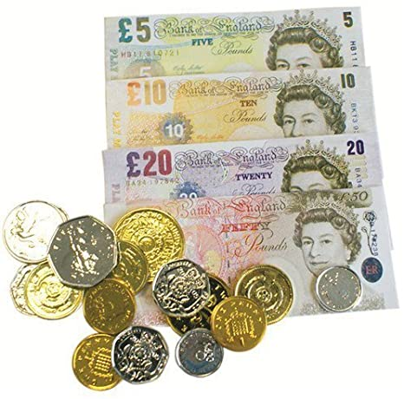
Stacy had £24. Adam had £15.
How much money did they have altogether?
How much more money did Stacy have?
Draw the bar model to represent each calculation
£24
£15
£24
£15

Slide 22

Sophie had a piece of string with a length of 25cm.
Bobby had a length that was 38cm.
What is the total length of their string.
What is the difference in their lengths?
25cm
38cm
38cm
25cm

Slide 23
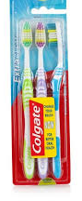
Structures for multiplication
Ratio (scaling)
4 times as many
Repeated addition (grouping)
+
+
+
= 3 x 4 = 12
Multiplicand multiplied by multiplier equals product
Notes:
How many groups of 4 are there in 12. Use equipment to illustrate. Where/what is the link with the multiplicand?

Slide 24


Structures for division
Ratio (scaling)
$$\frac{1}{4}$$
of the size/amount
Repeated subtraction (grouping)
12 – 4 – 4 – 4 3 groups of 4
12 ÷ 4 = 3
Dividend divided by divisor equals quotient
Sharing – links well to fractions
Notes:
How many groups of 4 are there in 12. Use equipment to illustrate. Where/what is the link with the multiplicand?

Slide 25
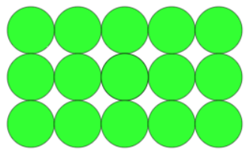
Year 1 (notes and guidance)
Through grouping and sharing small quantities, pupils begin to understand: multiplication and division; doubling numbers and quantities; and finding simple fractions of objects, numbers and quantities.
They make connections between arrays, number patterns, and counting in twos, fives and tens.
What can you see?
What else?
5 + 5 + 5 = 15
5 x 3 = 15
3 + 3 + 3 + 3 + 3 = 15
3 x 5 = 15
Like addition, multiplication is commutative.

Slide 26
What can you see?
What else?
How many groups of 2 frogs?
8 ÷ 2 = 4
2 + 2 + 2 + 2 = 8
2 x 4 = 8
How many groups of 4 frogs?
8 ÷ 4 = 2
4 + 4 = 8
4 x 2 = 8
How many eyes? How many feet?

Slide 27
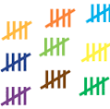
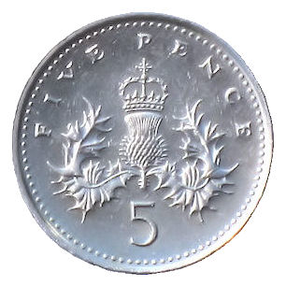

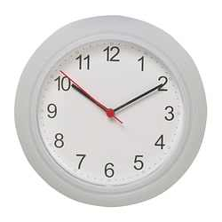
Counting in 5s
5, 10, 15, 20, 25, 30, 35, 40, 45…
5 x 9 = 45
How many groups of 5 fingers?
25 ÷ 5 = 5

Slide 28

Counting in 10s
10, 20, 30, 40, 50…
10 x 5 = 50
In the top row, how many groups of 10 pencils?
50 ÷ 10 = 5

Slide 29
Year 2
recall and use multiplication and division facts for the 2, 5 and 10 multiplication tables, including recognising odd and even numbers
calculate mathematical statements for multiplication and division within the multiplication tables and write them using the multiplication (×), division (÷) and equals (=) signs
show that multiplication of two numbers can be done in any order (commutative) and division of one number by another cannot
solve problems involving multiplication and division, using materials, arrays, repeated addition, mental methods, and multiplication and division facts, including problems in contexts.

Slide 30
What do you see?
What else?
4 x 3 = 12
3 x 4 = 12
4 - 4 – 4
12 ÷ 4 = 3
3 - 3 - 3 – 3
12 ÷ 3 = 4
3 lots of 4
4 lots of 3
4 + 4 + 4
3 + 3 + 3 + 3
1, 2, 3, 4, 5…..
Notes:
From this array – ask colleagues to discuss that they can see.
They will report multiplication, division, repeated addition, doubles, halves, quarters.
It is also possible to begin using the equal sign to show that 1 × 12 = 2 × 6 = 3 × 4
You will also note that above we have also just established all the factors of 12 (1, 2, 3, 4, 6 and12)
This picture can lead to very rich conversations.

Slide 31
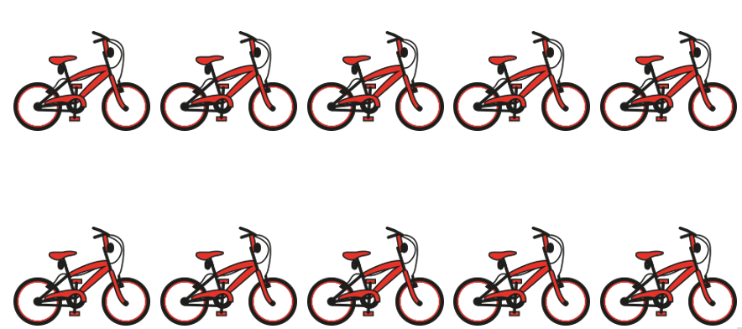
How many bikes?
5 + 5 = 10
5 x 2 = 10
What do you see?
What else?
How many groups of 5 bikes?
10 ÷ 5 = 2
How many wheels?
10 + 10 = 20
10 x 2 = 20
How many groups of 2 bikes?
10 ÷ 2 = 5

Slide 32
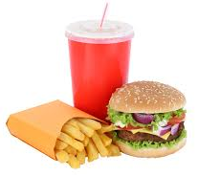
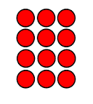
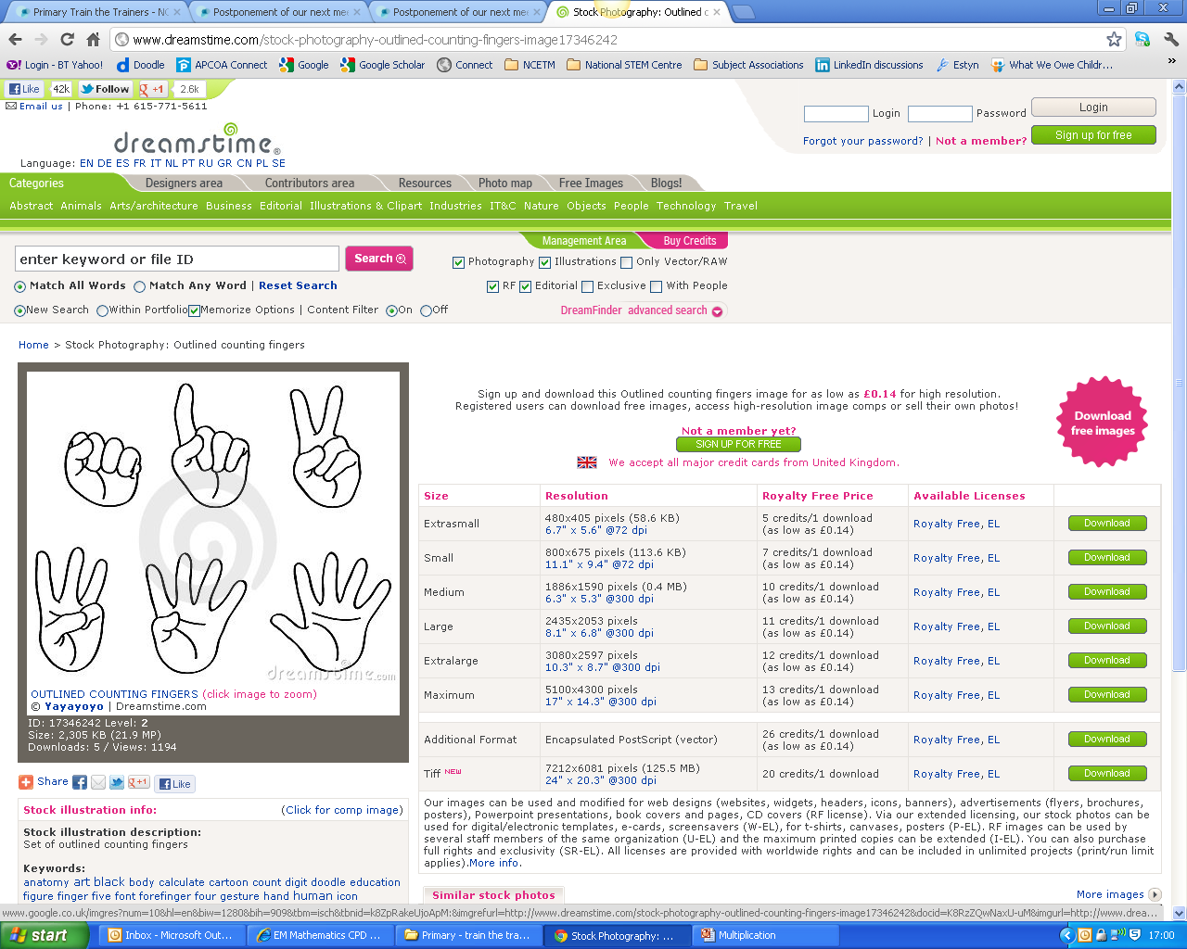
We encourage children to explore a variety of representations which is part of something we call variation.
3 6 9 12
0
3
6
9
12
Notes:
The images on the slide can represent multiplication or division depending on what is the unknown quantity.
3 toothbrushes in a pack, how many in 4 packs? 3 × 4 = 12 toothbrushes
12 toothbrushes, 3 in each pack, how many packs? 12 ÷ 3 = 4packs
12 toothbrushes, 4 in each pack, how many packs? 12 ÷ 4 =3 packs
The array illustrates both multiplication and division
3 × 4 = 12
4 × 3 = 12
12 ÷ 4 = 3
12 ÷ 3 = 4
Multiplication and division are formed by coordinating two ideas/quantities simultaneously, hence we refer to a binary procedure.
In addition and subtraction we add /subtract like things, for example apples, fruit etc. with multiplication and division we have two different ‘ideas’: the group of things, and the number of groups. The multiplicand and the multiplier.
The first structure for multiplication is referred to as ‘equal groups’ or ‘one to many correspondence
Nunes and Bryant (2008) refer to this type of multiplicative structure as direct ratio between two quantities.
These problems may also be called composite unit problems, isomorphism of measure, one to many correspondence problems. They can be solved by multiplication or division depending on which quantity is the unknown.
When the unit value is given there are three types of problems:
1. Each child who comes to our party will receive three balloons and eight children are coming. How many balloons are needed? 3 × 8 =? This is multiplication.
2. We have 24 balloons and eight children are coming to the party. How many balloons will each child get if we share them equally? This is known as partitive division. (Sharing model for division.)
24 ÷ 8 =? or 8 × ? = 24
3. Each child who comes to the party will get three balloons. We have 24 balloons. How many children can we invite? This is known as quotitive division. (Grouping model for division.) Put the 24 balloons into groups of three, how many groups of 3 are there?
24 ÷3 = ? or 3 × ? = 24
A major conceptual hurdle when working with multiplicative structures is understanding groups of items as single entities that contains a number of items – or unitising.

Slide 33
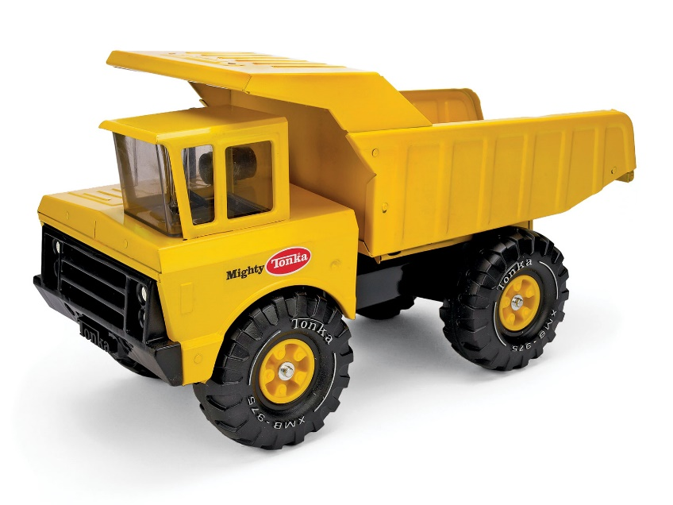

Sammy’s friend received 3 boxes of toy trucks.
In each box there were 5 trucks.
Sammy wants to know many trucks his friend had altogether.
Can you help him find out?
5 + 5 + 5 = 15
5 x 3 = 15

Slide 34
Sammy’s friend wanted to put his 15 trucks into boxes.
He wanted to put 3 trucks in each box.
Sammy wants to know many boxes his friend needs.
Can you help him find out?
15 – 3 – 3 – 3 – 3 – 3
5 boxes
15 ÷ 3 = 5

Slide 35

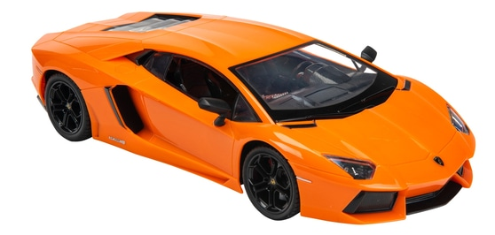
Scaling up
Sam
Sam had 2 toy cars.
Adam had 3 times as many.
How many toy cars did Adam have?
How many more toy cars did Adam have?
How many toy cars did they have altogether?
Adam
What if Sam had 3 toy cars?
What if Sam had 4 toy cars?
Make up your own number of toy cars that Sam could have had.
Answer the questions.
What if Sam had 5 toy cars?
What if Sam had 6 toy cars?

Slide 36
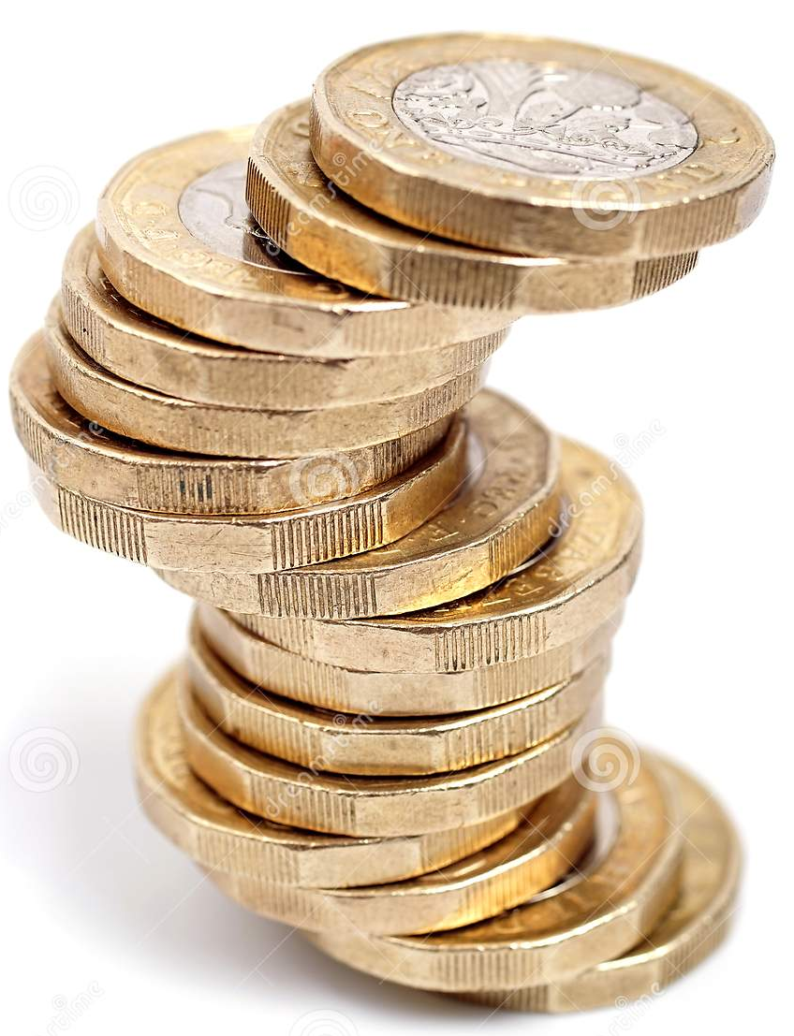

Scaling down
Samir
Georgie
Samir saved £4.
Georgie saved of that amount.
How much did Georgie save?
How many more did Samir save?
How much did they save altogether?
$\frac{1}{2}$
What if Samir saved £6?
Make up your own amounts of money.
Answer the questions.
What if Samir saved £8?
What if Samir saved £10?
What if Samir saved £12?

Slide 37
Multiplication tables
2 x 1
2 x 2
2 x 3
2 x 4
2 x 5
2 x 6
2 x 7
2 x 8
2 x 9
2 x 10
These begin when children count in steps of different sizes.
They will have been counting in steps of 2, 5 and 10 in Reception.
Now the facts need to be learned. Frequently recite facts.
Let them use their fingers as support.
Link to number lines.
Interesting visuals for children to look at. Get to the stage when you ask ‘What are 6 twos?’
2 4 6 8

Slide 38
Multiplication tables
5 x 1
5 x 2
5 x 3
5 x 4
5 x 5
5 x 6
5 x 7
5 x 8
5 x 9
5 x 10
5 10 15 20
What are 6 fives?
What are 9 fives?
What are 3 fives?
What are 8 fives?

Slide 39
10 20 30 40
Multiplication tables
10 x 1
10 x 2
10 x 3
10 x 4
10 x 5
10 x 6
10 x 7
10 x 8
10 x 9
10 x 10

Slide 40
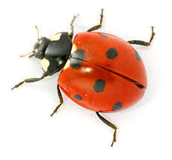










Division as sharing with links to fractions
Share the ladybirds equally onto each leaf.
There are 4 ladybirds on each leaf.
of 8 = 4
$$\frac{1}{2}$$
What about…
$$\frac{1}{2}$$
of 12?
$$\frac{1}{3}$$
of 12?
$$\frac{2}{3}$$
of 12?
$$\frac{3}{3}$$
of 12?
$$\frac{1}{4}$$
of 12?
$$\frac{2}{4}$$
of 12?
$$\frac{3}{4}$$
of 12?
$$\frac{4}{4}$$
of 12?

Slide 41

Ella has some cherries.
She eats one half of them.
She has 3 left.
How many did she have to begin with?
What if Ella has 4 cherries left?
What if Ella has 5 cherries left?
What if Ella has 10 cherries left?
What if Ella has 15 cherries left?
Make up your own numbers of cherries that Ella could have left.
Notes:
Use the frame, act it out.
Discuss what’s the same what’s different between the two sets of questions (slides 14 and 15).
Same – context, name, cherries…
Different – unknown starting point ‘some cherries’ on slide 15,
Both sets of activities reinforce the importance of equal groups/ equal parts for the

Slide 42
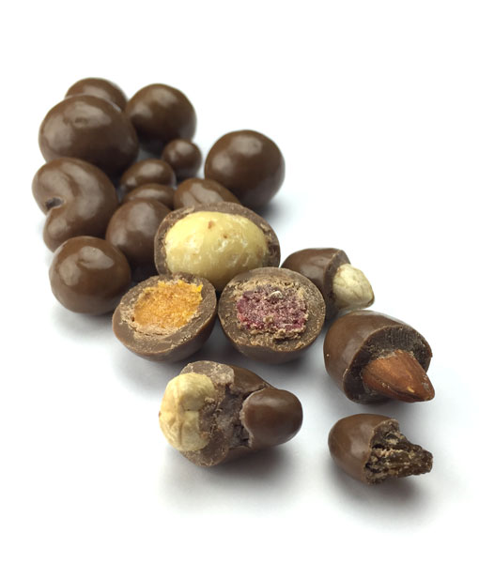
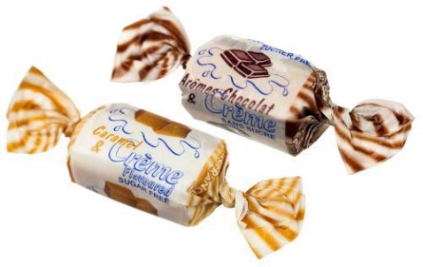
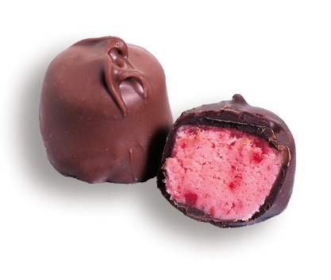


$$\frac{1}{2}$$
of the sweets in the tin were chocolates.
were toffees.
The rest were strawberry creams.
There were 4 strawberry creams.
How many sweets were in the tin?
$$\frac{1}{4}$$
What if there were 10 strawberry creams?
What if there were 15 strawberry creams?
What if there were 20 strawberry creams?
Make up your own numbers of strawberry creams.

Slide 43
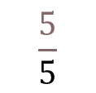
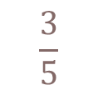
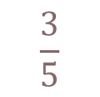









We also give children problems that involve adding and subtracting fractions.
If we know how to add and subtract whole numbers we can apply that to fractions.
2 + 3 = 5
2 apples + 3 apples = 5 apples
£2 + £3 = £5
Therefore…
$$\frac{2}{5}$$
$$\frac{3}{5}$$
$$\frac{5}{5}$$
$$\frac{3}{5}$$
$$\frac{2}{5}$$
$$\frac{5}{5}$$
+ =
+ =
$$\frac{5}{5}$$
$$\frac{3}{5}$$
$$\frac{2}{5}$$
$$\frac{5}{5}$$
$$\frac{2}{5}$$
$$\frac{3}{5}$$
- =
- =

Slide 44








Peter buys a pie.
He cuts the pie into 8 equal parts.
He eats 3 pieces.
What fraction of the pie does he eat?
What fraction of the pie is left?
$$\frac{3}{8}$$
$$\frac{5}{8}$$
$$\frac{8}{8}$$
+ =
$$\frac{8}{8}$$
$$\frac{3}{8}$$
$$\frac{5}{8}$$
- =

Slide 45












$$\frac{1}{5}$$
Ella eats of a pizza.
Tom eats of it.
What fraction do they eat altogether?
What fraction is left?
$$\frac{2}{5}$$
$$\frac{1}{5}$$
$$\frac{2}{5}$$
$$\frac{3}{5}$$
$$\frac{2}{5}$$
$$\frac{1}{5}$$
$$\frac{3}{5}$$
+ =
+ =
$$\frac{5}{5}$$
$$\frac{3}{5}$$
$$\frac{2}{5}$$
- =

Slide 46













$$\frac{3}{7}$$
Suzie reads of her book before dinner.
She reads after dinner.
What fraction of her book did she still have to read?
$$\frac{2}{7}$$
$$\frac{3}{7}$$
$$\frac{2}{7}$$
$$\frac{5}{7}$$
$$\frac{2}{7}$$
$$\frac{3}{7}$$
$$\frac{5}{7}$$
+ =
+ =
$$\frac{7}{7}$$
$$\frac{5}{7}$$
$$\frac{2}{7}$$
- =

Slide 47






Other key vocabulary
Bus stop
Crocodiles only eat meat!
equal to… equivalent… same as NOT
Numerator
$$\frac{1}{10}$$
Vinculum (line that separates the numerator and denominator)
Denominator

Slide 48

Commutative: doesn’t matter which order you add/multiply the sum/product will be the same.
Inverse: addition and subtraction, multiplication and division are inverse operations, use one to check the other.
Inverse structures for multiplication and division: grouping (repeated addition and subtraction) and scaling (x times as many, a fraction of the amount).
Zero: indicates nothing, main role is as a place holder.
O v 0
Pence: use pence not p when referring to money, p is a little green vegetable!
Dot: dot, not a decimal point, separates the pounds and pence.
If referred to as a decimal point, it can confuse due to the convention of how we say decimals: 6.25m = 6 point two five metres
£6.25 = 6 pounds 25 pence not 6 point two five pounds
Precise mathematical process vocabulary
  Compare, estimate, exchange, regroup, partition

Slide 49


Any questions?

